Slide 1
OŠ JOSIPOVAC PRIMARY SCHOOL JOSIPOVAC
REPUBLIKA HRVATSKA
CROATIA
„Christmas around the world 2017”
eTwinning project

Slide 2
Our school is near Osijek
Josipovac

Slide 3
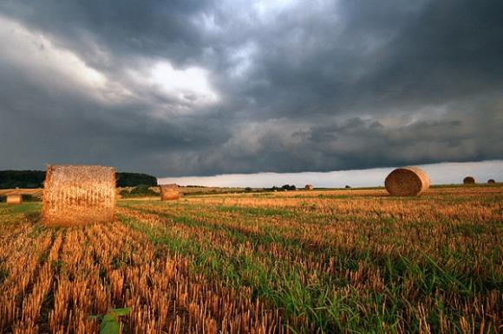
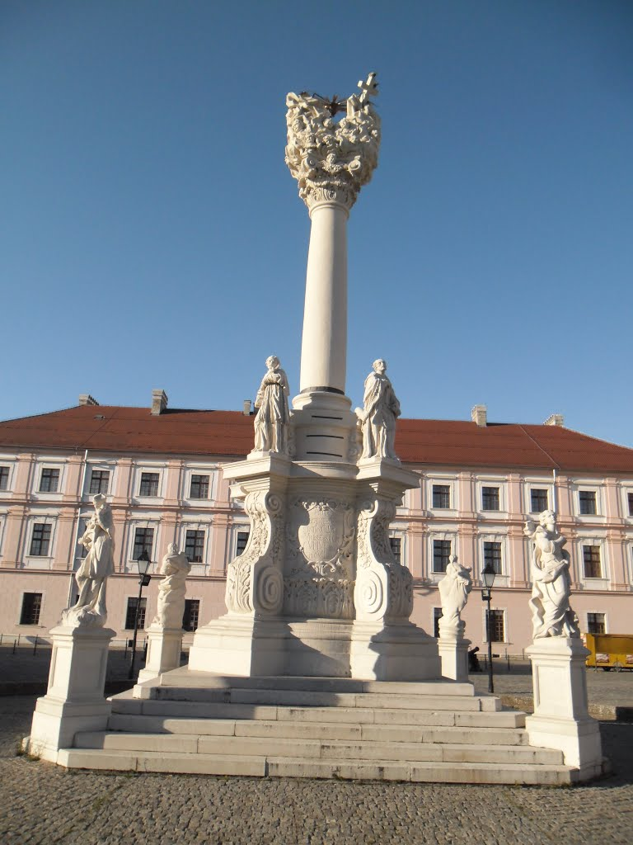
Osijek

Slide 4
Osnovna škola Josipovac – Primary school Josipovac

Slide 5
Announcement of our project at the school library

Slide 6
A school group of journalists – eTwinning team
Students: Barbara, Borna, Ema, Katja, Luka, Mirela, Urban, Vlatka
Teacher/Librarian: Anita Drenjančević

Slide 7
Christmas traditions in Croatia
Christmas customs are an important part of Croatian tradition. Although Croatia is a relatively small country, it has a surprisingly large number of customs and traditions, which also vary from region to region.
Advent Sunday marks the beginning of the season of Advent. . On this day, the first (of four) candles in the Advent wreath is lit.

Slide 8
St. Nicholas' Day – 6th December
On the eve of St. Nicholas' Day, children polish their boots and leave them on the window sill, hoping that St. Nicholas will bring them gifts, usually sweets.
But those children who weren't good, polite and obedient to their parents get sticks instead!
St. Nicholas is accompanied by Krampus, a hairy demon. While Nicholas rewards the good children, it's Krampus who leaves sticks for the children who behaved badly so that their parents can discipline them!

Slide 9
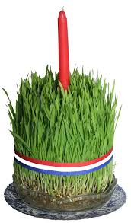
St. Lucia's Day - 13th December
Mothers – or, sometimes, daughters – plant wheat grains, usually in a round dish, which is known as Christmas wheat. People in some regions plant Christmas wheat even earlier – on St. Barbara's day, 4th December, so that the wheat could grow even taller before Christmas.
It's believed that the taller the wheat grows, the more prosperous the coming year will be.
By Christmas Eve, the wheat, now hopefully tall, green and beautiful, is tied with a ribbon in red, white and blue – the colours of the Croatian flag.

Slide 10
Decorating Christmas trees and homes
Children were usually in charge of decorating their homes on Christmas Eve. Apart from flowers and fruits, children used to make paper ornaments.

Slide 11
Christmas workshop in library

Slide 12
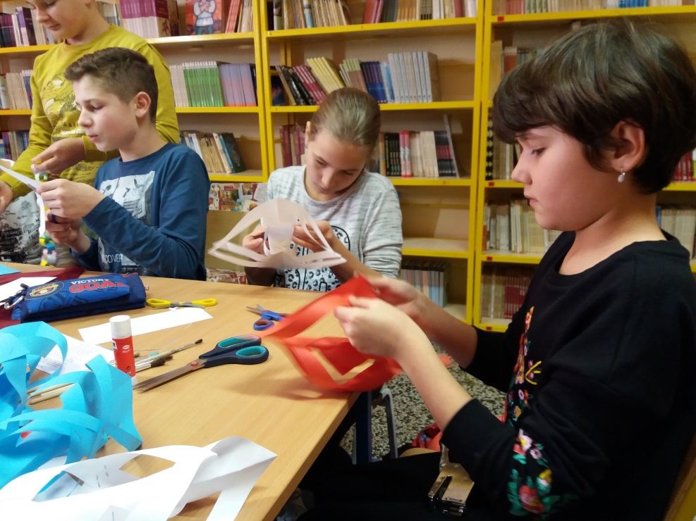

Slide 13
School library is ready for Christmas

Slide 14
Books abouth Christmas in our school library

Slide 15
Merry Christmas!!! Sretan i blagoslovljen Božić!
Croatian eTwinning team from OŠ Josipovac
http://os-josipovac.skole.hr/

