Slide 1
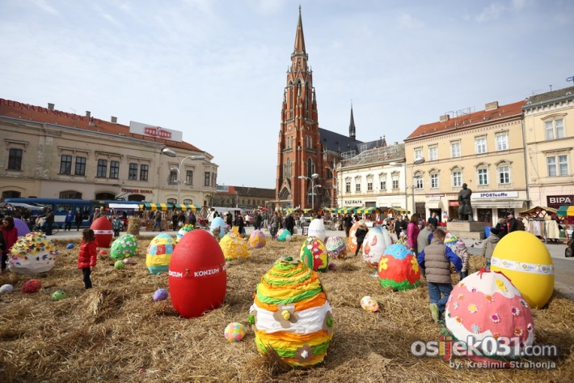
EASTER IN CROATIA
eTwinning project „Let's celebrate Easter in Europe!” 2019.
OŠ Josipovac, Croatia

Slide 2
EASTER - USKRS
Easter is the holiest day of the year in Croatia
Preparations for Easter lasts 40 days and end on the Sunday before Easter – Palm Sunday, after which begins the Holy Week.
Easter is celebrated each year on a different date, but it is still one of the Sundays between the 22nd March and 25th April.

Slide 3
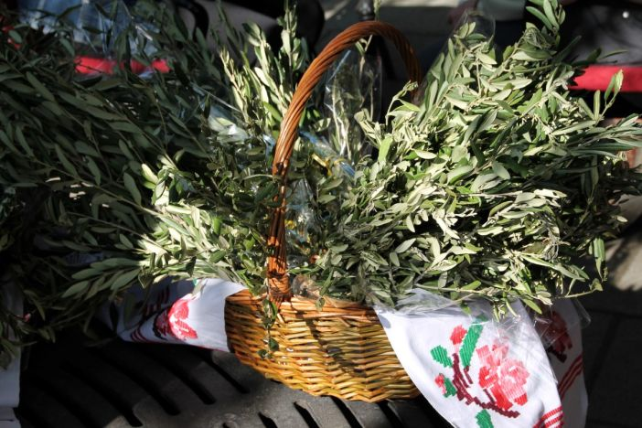
PALM SUNDAY - CVIJETNICA
On Palm Sunday morning girls are tending their faces in water with flowers to be beautiful all year round
Since palms are scarce in Croatia, olive or rosemary branches are an acceptable substitute
The branches are decorated with ribbons and flowers and woven into wreaths or crosses, known as poma
They are taken to a church to be blessed. After the blessing, the poma are hung around the house as protection against bad luck and evil spirits

Slide 4
GOOD FRIDAY - VELIKI PETAK
Good Friday is a traditional fast and abstinence and most eaten fish
In the Croatian mainland are mostly eaten nuts, dried fruits, compotes
At the continental patterns and pike, in Istra and Dalmatia coast saltwater fish and seafood
Strict post means that once a day eats satisfied, while the other two meals are symbolic

Slide 5
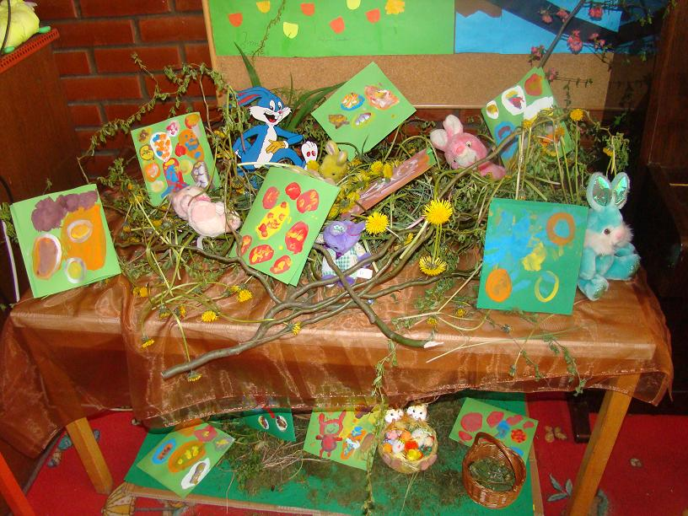
A RABBIT NEST – GNIJEZDO ZA ZECA
In Slavonia (east of Croatia)is the custom that little children on Saturday make a nest for rabbits that will bring them gifts for the Easter
They are mostly eggs, sweets and a small toys

Slide 6
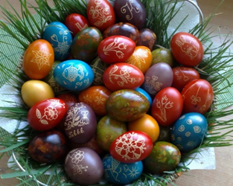
EASTER EGGS - PISANICE
Pisanice (from the Croatian word for "colored") are brightly painted eggs, decorated in the different styles of the regions, following an old Slavic custom from pagan times
Before paint became common, villagers used natural dyes made from plants and vegetables
The most common phrase put on pisanice is "Sretan Uskrs" or "Happy Easter." Other decorations are doves, crosses, flowers and wishes for health and happiness

Slide 7
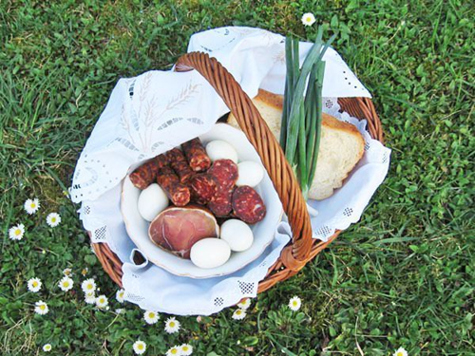
EASTER BREAKFAST – USKRŠNJI DORUČAK
The faithful attend a early morning Mass at which the foods in their baskets are blessed and eaten for breakfast on Easter morning
Traditional Easter breakfast foods are eggs, ham (which is sometimes baked in a bread) or roast lamb, along with raw radishes, spring onions, and horseradish (hren)

Slide 8
TRADITIONAL GAME ON EASTER DAY – TUCANJE JAJA
On Easter day, a traditional game is played in which at least two people choose eggs and hold them vertically while one person lightly taps the end of the other egg with their end, to see whose will crack
Anyone whose egg cracks must choose another and then tap the other person’s egg, and they continue until all the eggs have been used and cracked but the last one
Whoever holds the strongest egg at the end and whose has not been cracked wins

Slide 9
EASTER CAKES – USKRŠNJI KOLAČI
The inevitable part of the celebration of any holiday in Croatia, and also in Easter, are cakes
Mothers make about a dozen types of cakes according to their grandmothers' traditional recipes

Slide 10
Sretan Uskrs!

