Slide 1
THE EATHING HABITS OF CROATIAN TEENAGERS
for eTwinning project 2018.
(a survey conducted in October and November 2018.)

Slide 2
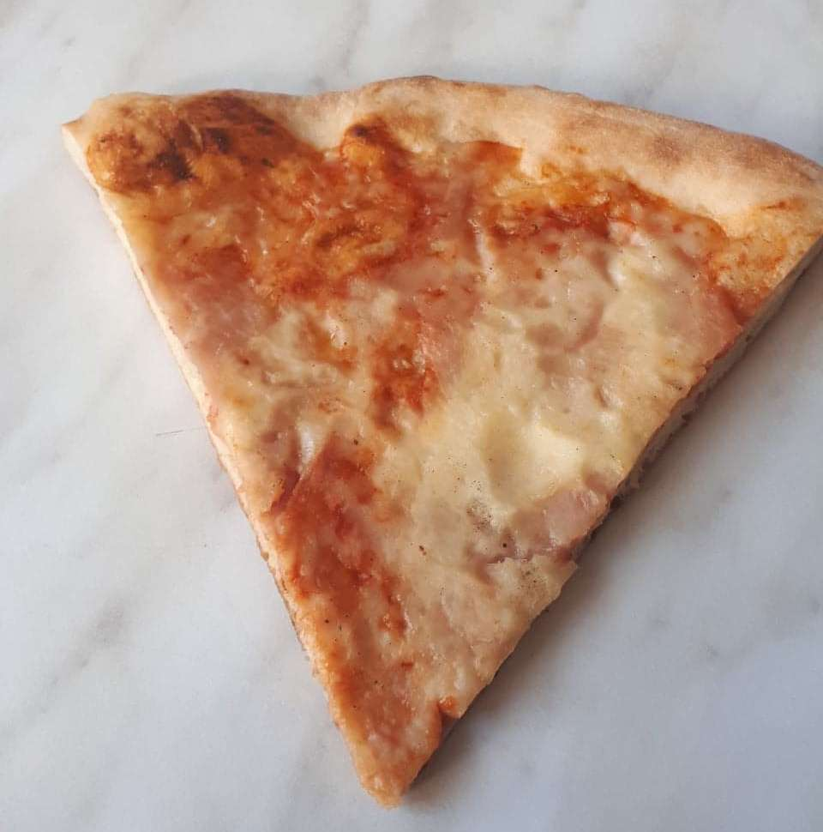
BREAKFAST (at school)
PIZZA
PIZZA
KRUH S PAŠTETOM I BANANA
BREAD WITH PÂTÉ AND BANANA
BUREK SA SIROM I JOGURT
BUREK(STRUDEL) WITH CHEESE AND YOGURT

Slide 3
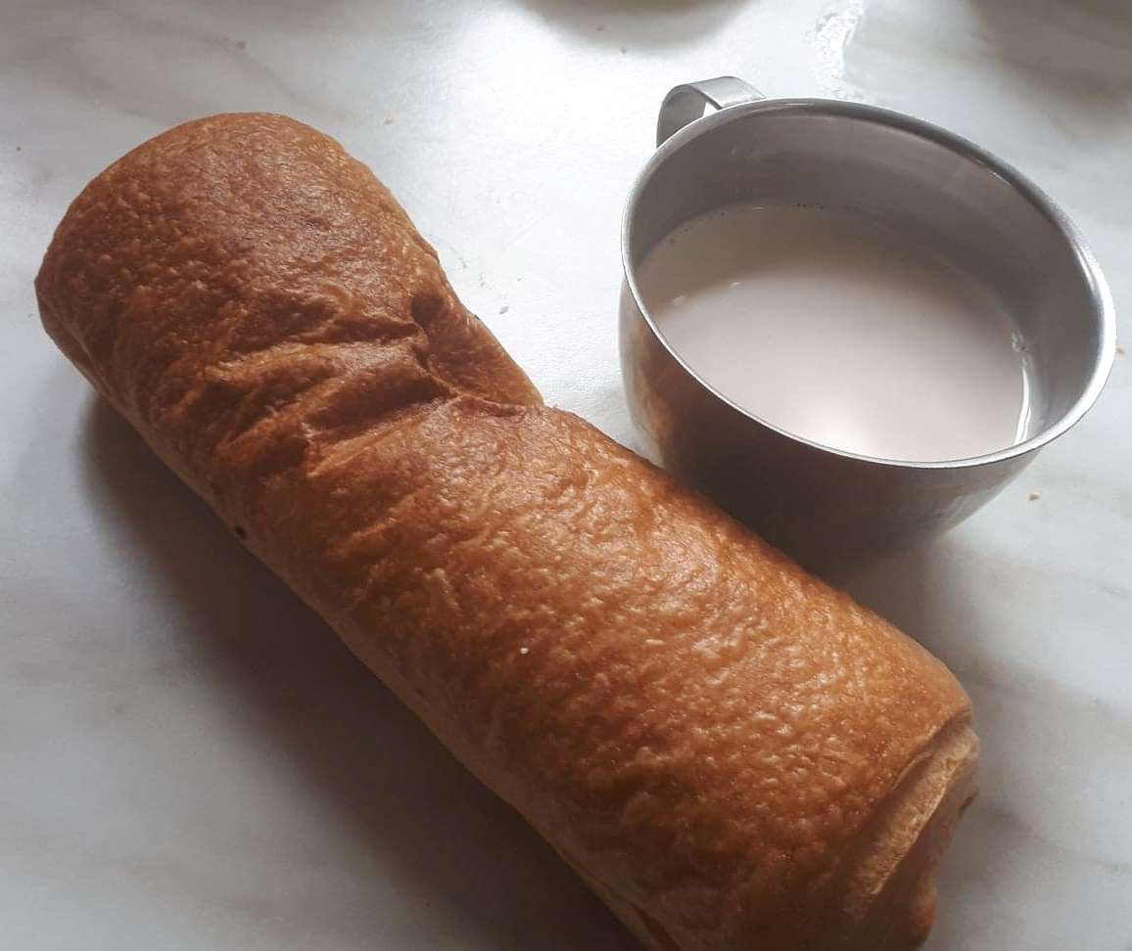
KAKAO I PRIOŠKA S ČOKOLADOM
COCOA AND BAGEL WITH CHOCOLATE
JABUKA I PIROŠKA SA SIROM
APPLE AND BAGEL WITH CHEESE
ČOKOLADNO MLIJEKO I SENDVIČ SA SALAMOM I SIROM
CHOCOLATE MILK AND SANDWICH

Slide 4
JOGURT I SLANAC
YOGURT AND BAGEL
SOK I SENDVIČ SA SALAMOM I SIROM
JUICE AND SANDWICH
HRENOVKA I KRUH
HOT DOG WITH BREAD

Slide 5
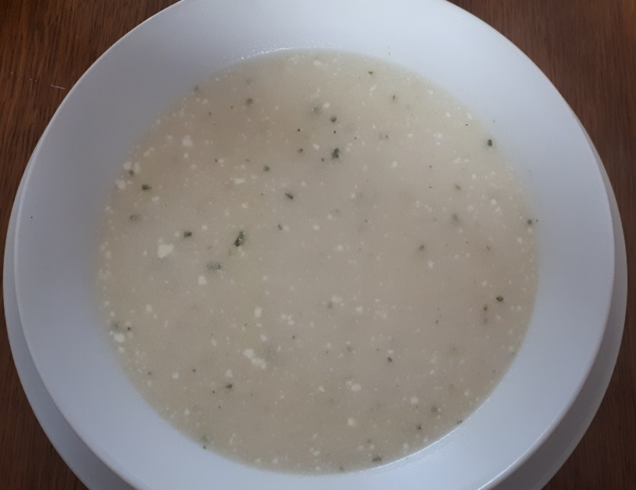
LUNCH (at home)
WOK
WOK
VARIVO S POVRĆEM
STEWED VEGETABLES
JUHA OD GLJIVA
MUSHROOM SOUP

Slide 6
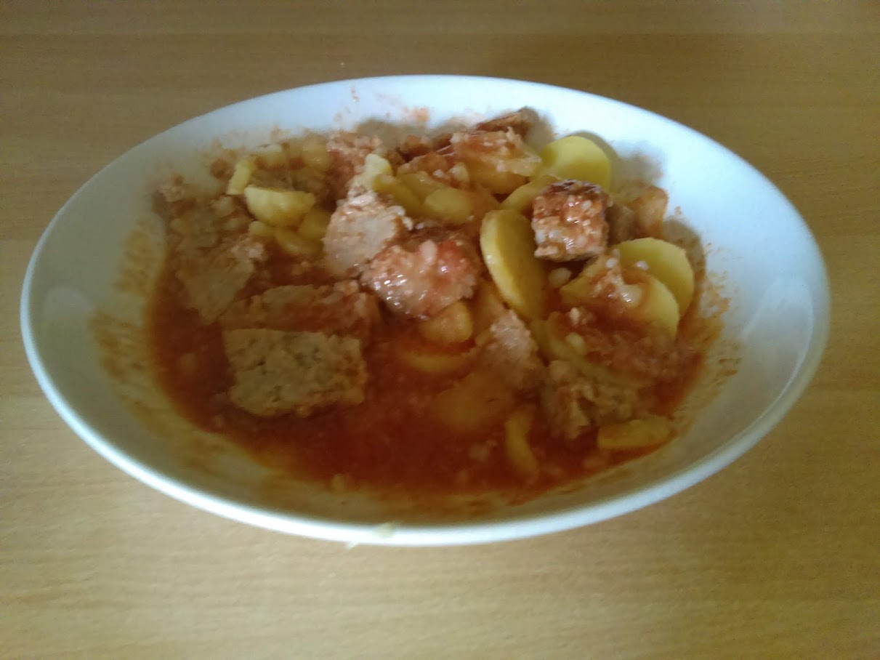
ĆUFTE SA KRUMPIROM MEATBALLS WITH POTATO
JUHA OD BROKULE
BROCCOLI SOUP
TJESTENINA SA MLJEVENIM MESOM
PASTA WITH MINCED MEAT

Slide 7
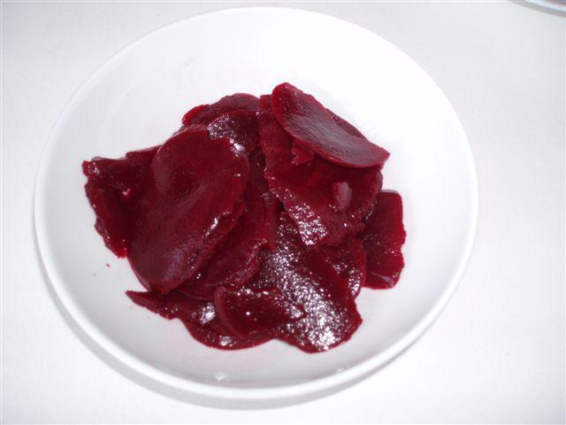
POVRĆE NA ŽARU SA FETA SIROM
GRILLED VEGETABLES WITH FETA CHEESE
TJESTENINA SA SIROM
PASTA WITH CHEESE
UKISELJENA CIKLA
PICKLED RED BEET

Slide 8
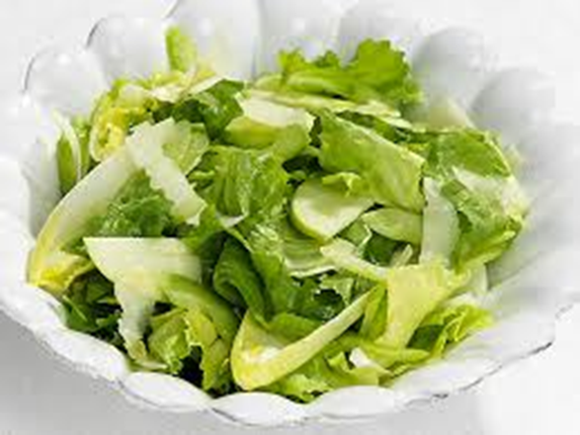
TJESTENINA S KRUMPIROM
PASTA WITH BOILED POTATOES
VARIVO OD MAHUNA I ZAGREBAČKI ODREZAK
STEWED GREEN BEANS AND STEAK
ZELENA SALATA
GREEN SALAD

Slide 9
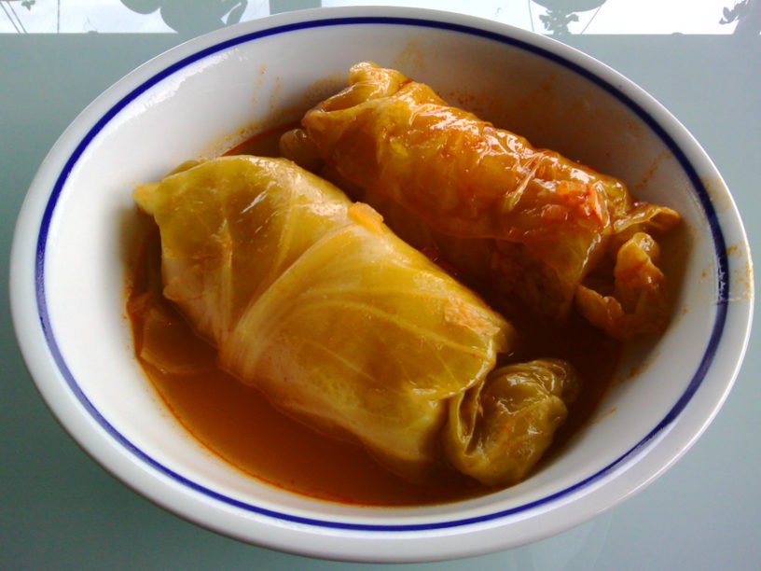
CRVENI KUPUS
RED CABBAGE
GRAH
BEANS
SARMA
CABBAGE ROLLS

Slide 10
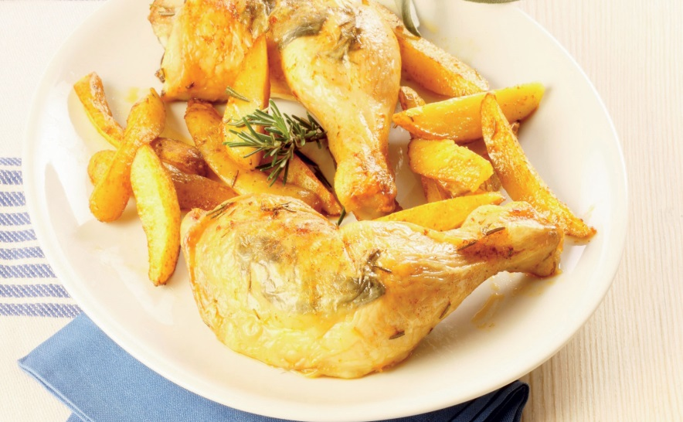
FIŠ PAPRIKAŠ
FISH STEW
PILEĆA JUHA
CHICKEN SOUP
PEČENA PILETINA S KRUMPIROM
ROAST CHICKEN WITH POTATO

Slide 11
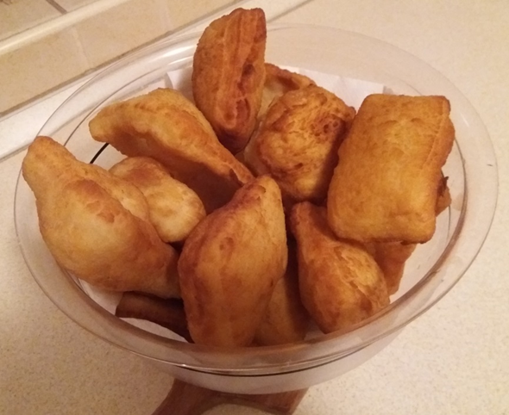
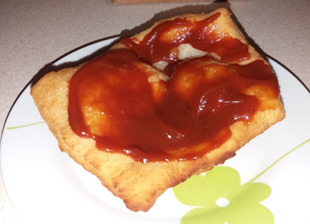
DESSERT
VOĆNI KRUH
FRUIT BREAD
KUGLOF
ROUND CAKE WITH CHOCOLATE
LEPINJA/LANGOŠICA S PEKMEZOM
LANGOS WITH JAM

Slide 12
GUŽVARA S MAKOM I ORASIMA
STRUDEL WITH POPPY AND WALNUT
PALAČINKE S MARMELADOM
PANCAKES WITH JAM

Slide 13
Dobar tek! Enjoy your meal!

