Slide 1
Traditional games
OŠ Josipovac, Croatia

Slide 2
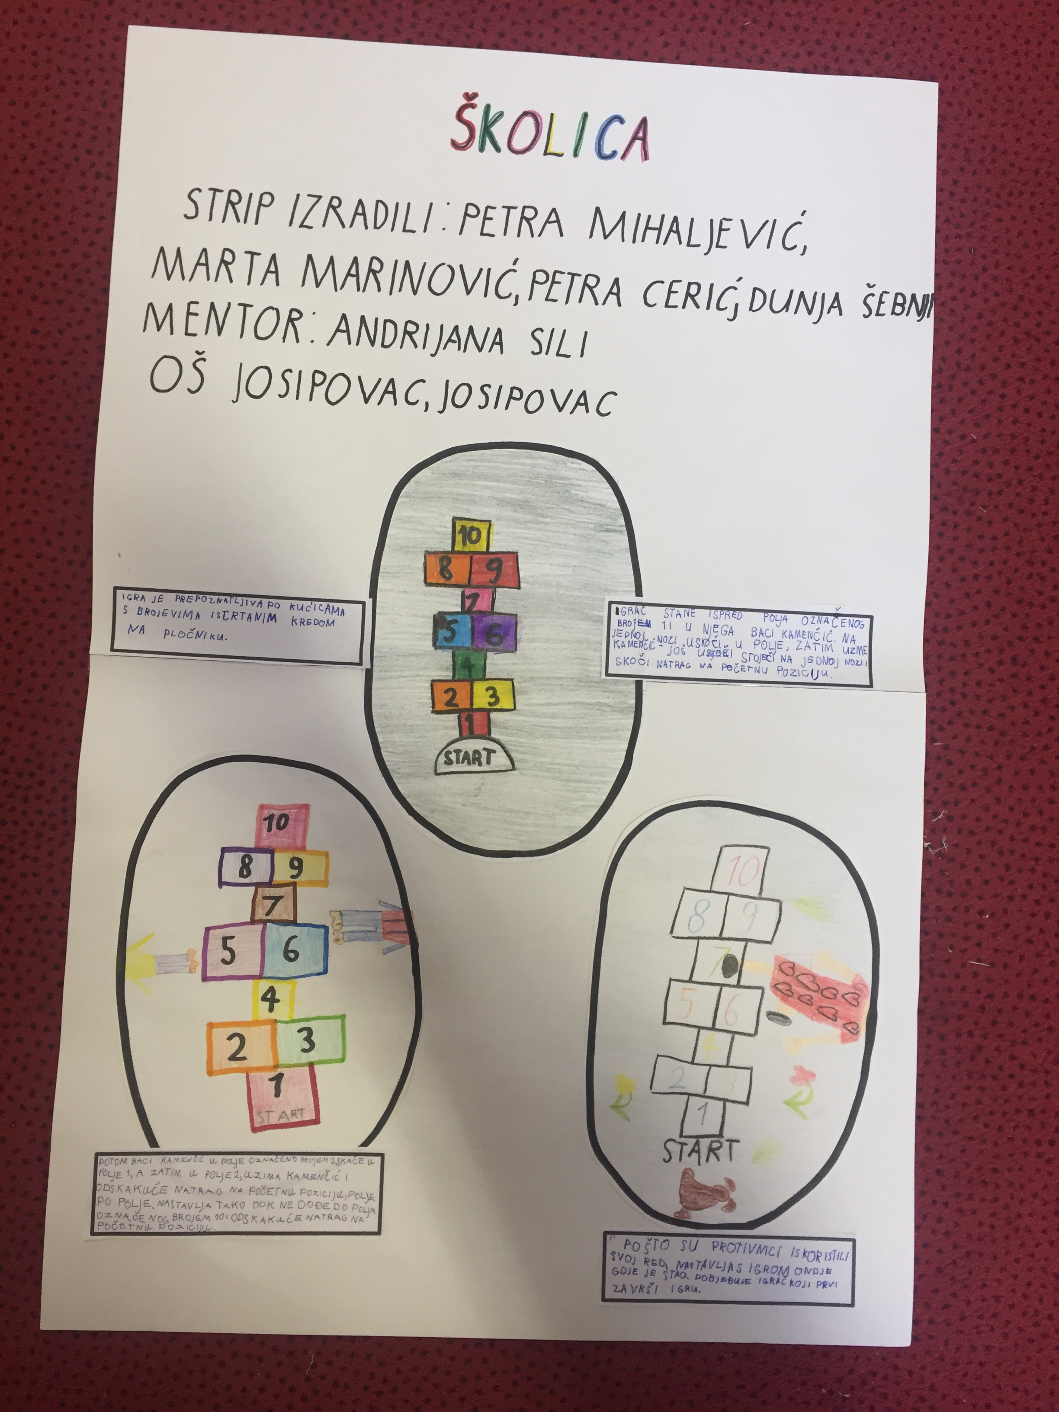
ŠKOLICA - HOPSCOTCH
A child's game, in which a player, hopping on one foot, drives a stone from one compartment to another of a figure traced or scotched on the ground.

Slide 3
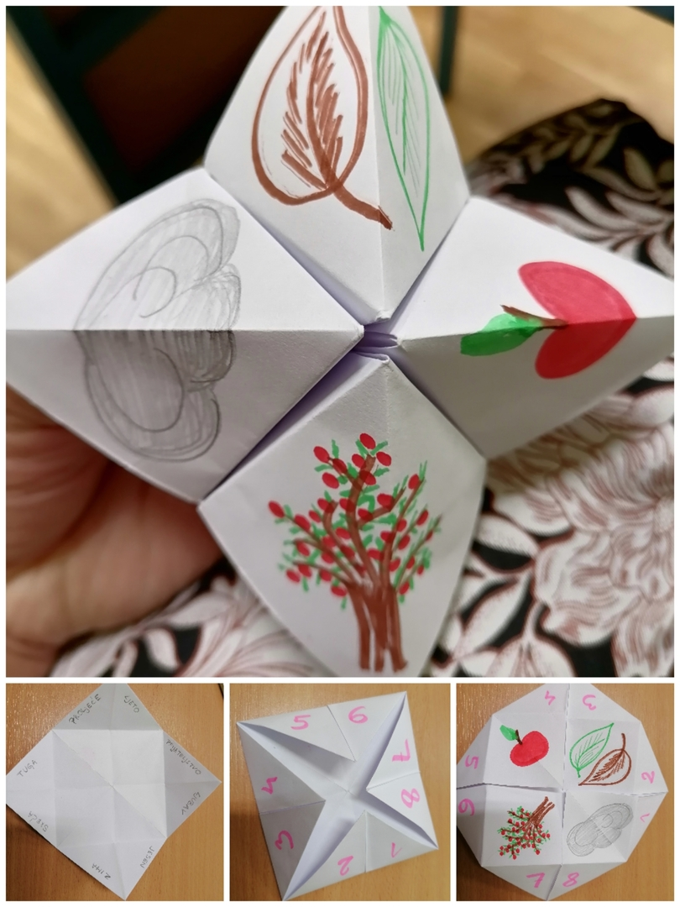
ŽABICE - FROGS
„Frog” is made from paper (watch the video tutorial)
After the frog is made of paper, a character is drawn on each part or numbers are written. In the last hidden part, the tasks that must be performed are written (eg jumping on one leg, drinking a glass of water).
The student first selects one external sign and the frog moves as many times as the sign has letters, or as many times as the number chosen.
The same thing is repeated with the sign inside, and the task is opened for the third time.

Slide 4
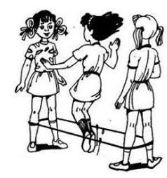
GUMI-GUMI
A children's game in which an elastic band is skipped.
There are several variations, the easiest is the one where you play from 1 to 9 so that each time the tire is skipped as many times as you are on the number
It starts from the lightest level, the ankles and after each round the tire is lifted (ankles, knees, buttocks, waist)
Watch the video tutorial

Slide 5
Anita Drenjančević
Andrijana Sili
We wish you many fun moments!

